Slide 1
Electrochemistry for Materials Technology
Chapter 3. Electrodeposition of alloys and solid solutions

Slide 2
Some examples of electrodeposited alloys
Protective & decorative | Corrosion resistant | Magnetic alloys | Heat resistant allloys | Electronic & jewelry | Antifriction
NiZn NiAu NiCd NiSn AuCu AuAg CuSn | ZnCd ZnSn CrNi CrRe | NiCo NiFe CoW CoPt FePt | CrMn CrW CrMo WFe | PdNi AuNi AuCo | PbAg InPb PbCu AgSn

Slide 3
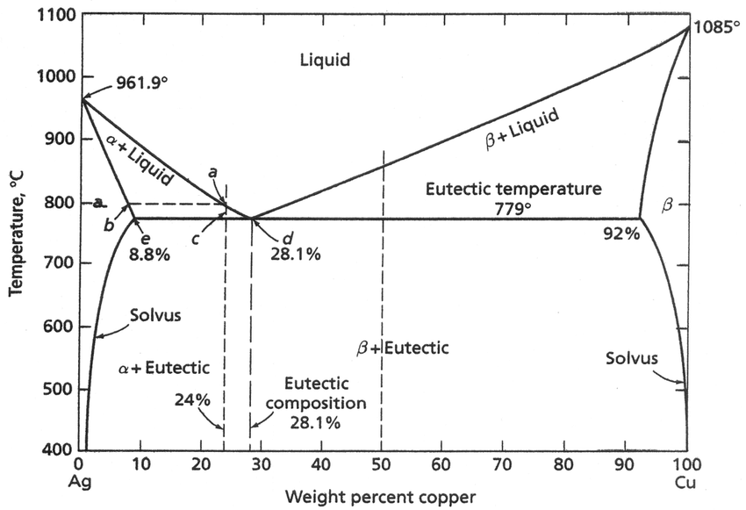
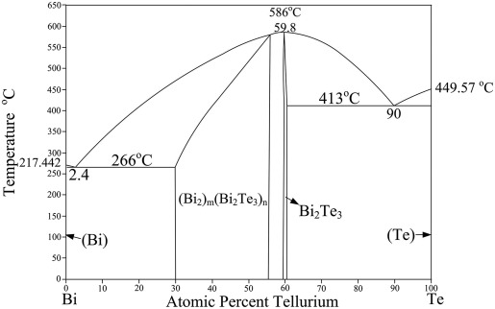
I) Alloys and solid solutions
SS-type
Bi_{2-x}Te_{3+x}
Phase diagram for metallurgy only useful for predicting the phase-type
Localized electrocrystallization enables single phases with wider composition range
Highly dispersed supersaturated solid solutions can be electroplated
Metastable: decompose upon annealing

Slide 4
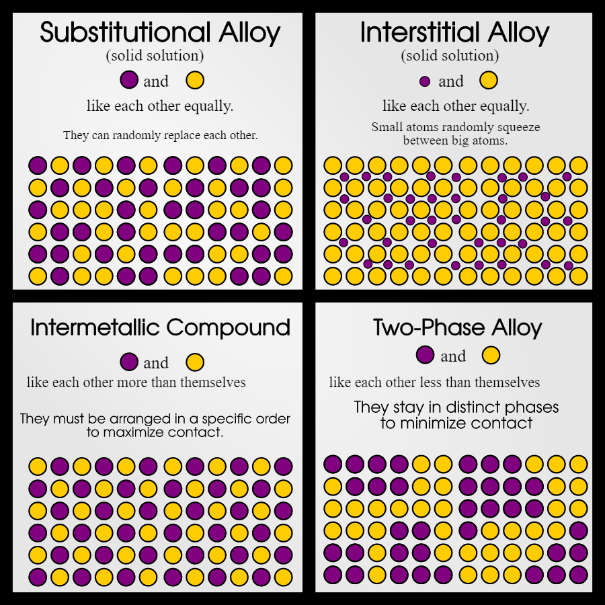
I) Alloys and solid solutions
Substitutional solid solution:
B randomly replace A
Interstitial solid solution:
Smaller atoms in random interstitial sites
Intermetallic alloys:
A and B form a new lattice
Bimetallic:
No mixing of A and B

Slide 5
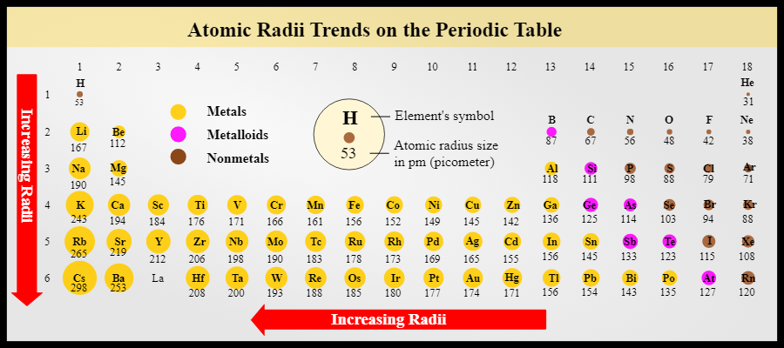
I) Alloys and solid solutions
Intrinsic internal stress due to differences of atom radii
Interstitial atom: B_{i}* → compressive stress
Substitution: B_{a}^{x} → compressive if r_{B} > r tensile if r_{B} < r_{A}

Slide 6
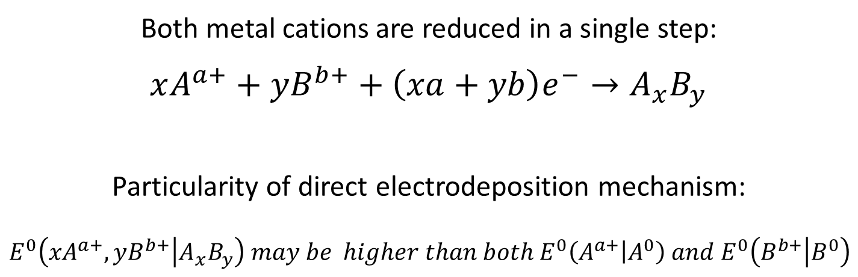
II) Electrodeposition of several elements
1) Direct deposition process
Both metal cations are reduced in a single step:
$$xA^{a+}+yB^{b+}+\left(xa+yb\right)e^{−}→A_{x}B_{y}$$
Particularity of direct electrodeposition mechanism:
$$E^{0}\left({xA}^{a+},yB^{b+} | A_{x}B_{y}\right) may be higher than both E^{0}\left(A^{a+} | A^{0}\right) and E^{0}\left(B^{b+} | B^{0}\right)$$
Not possible to deposit only one cation selectively
x and y still depend on the overpotential and the mass transfer of individual species

Slide 7
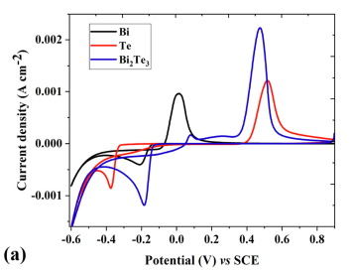
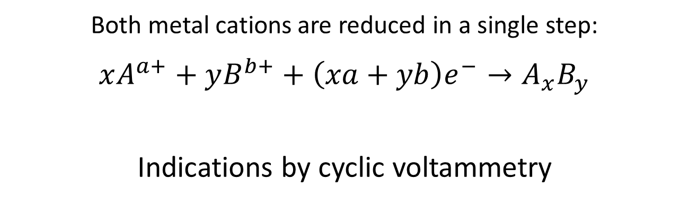
II) Electrodeposition of several elements
1) Direct deposition process
Both metal cations are reduced in a single step:
$$xA^{a+}+yB^{b+}+\left(xa+yb\right)e^{−}→A_{x}B_{y}$$
Indications by cyclic voltammetry

Slide 8

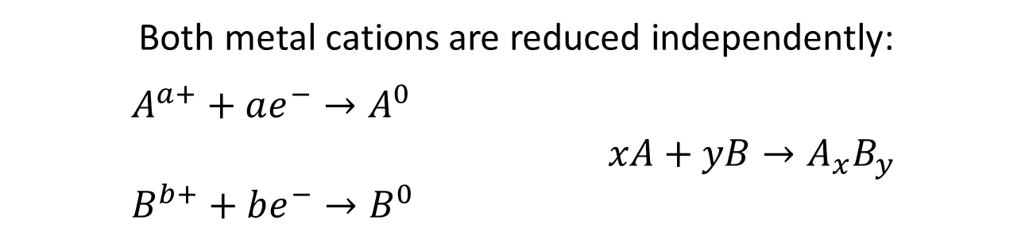




II) Electrodeposition of several elements
2) Co-deposition process
Both metal cations are reduced independently:
$A^{a+}+ae^{−}→A^{0}$
$xA+yB→A_{x}B_{y}$
$B^{b+}+be^{−}→B^{0}$
i
$$B^{0}→B^{b+}+be^{−}$$
$$A^{0}→A^{a+}+ae^{−}$$
E
$$i_{lim}^{B}$$
$$i_{lim}^{A}$$
$$A^{0}←A^{a+}+ae^{−}$$
$$B^{0}←B^{b+}+be^{−}$$

Slide 9

II) Electrodeposition of several elements
2) Co-deposition process
Both metal cations are reduced independently:
$A^{a+}+ae^{−}→A^{0}$
$xA+yB→A_{x}B_{y}$
$B^{b+}+be^{−}→B^{0}$
i
$$B^{0}→B^{b+}+be^{−}$$
$$A^{0}→A^{a+}+ae^{−}$$
E
$$i_{lim}^{B}$$
$$i_{lim}^{A}$$
$$i_{lim}^{A}+i_{lim}^{B}$$
$$A^{0}←A^{a+}+ae^{−}$$
$$B^{0}←B^{b+}+be^{−}$$

Slide 10
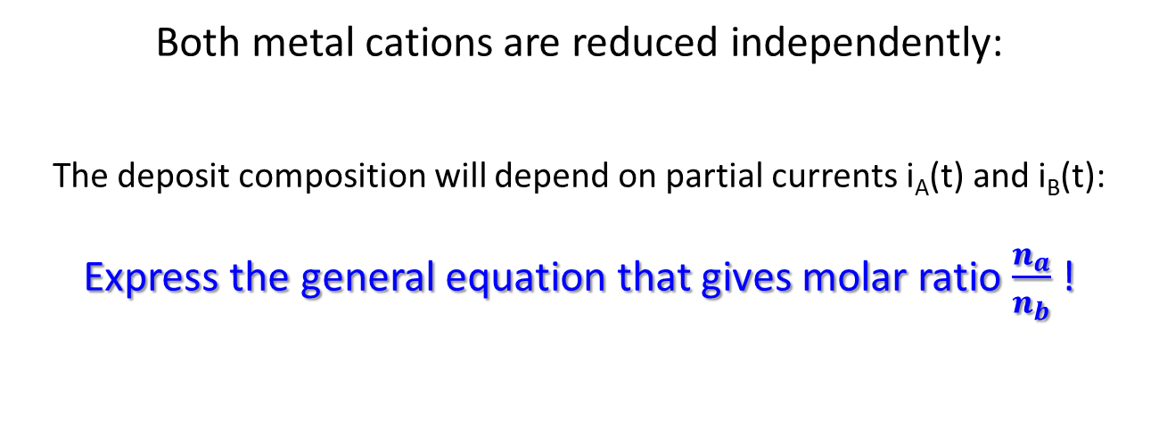
II) Electrodeposition of several elements
2) Co-deposition process
Both metal cations are reduced independently:
The deposit composition will depend on partial currents i_{A}(t) and i_{B}(t):
Express the general equation that gives molar ratio $\frac{n_{a}}{n_{b}}$ !

Slide 11
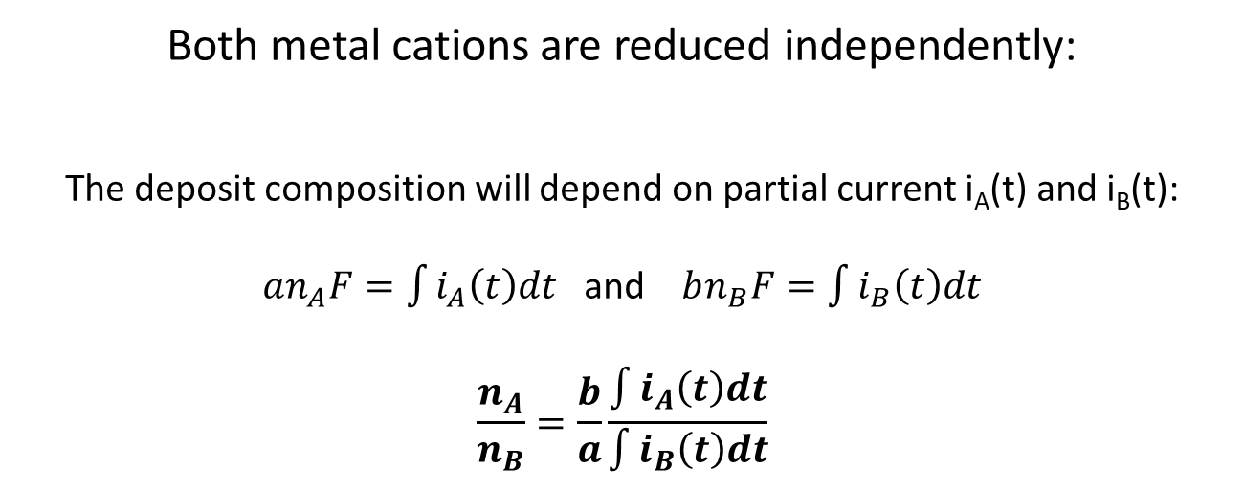
II) Electrodeposition of several elements
2) Co-deposition process
Both metal cations are reduced independently:
The deposit composition will depend on partial current i_{A}(t) and i_{B}(t):
$an_{A}F=\int{i_{A}\left(t\right)dt}$ and $bn_{B}F=\int{i_{B}\left(t\right)dt}$
$$\frac{n_{A}}{n_{B}}=\frac{b}{a}\frac{\int{i_{A}\left(t\right)dt}}{\int{i_{B}\left(t\right)dt}}$$

Slide 12
II) Electrodeposition of several elements
2) Co-deposition process
Both metal cations are reduced independently:
Co-deposition of A and B is carried out at overpotentials sufficiently high so that only mass transfer controls the kinetics.
What parameters will allow you to tune the composition?
i
E_{ECD}
$$B^{0}→B^{b+}+be^{−}$$
$$A^{0}→A^{a+}+ae^{−}$$
E
$$i_{lim}^{B}$$
$$i_{lim}^{A}$$
$$i_{lim}^{A}+i_{lim}^{B}$$
$$A^{0}←A^{a+}+ae^{−}$$
$$B^{0}←B^{b+}+be^{−}$$

Slide 13

II) Electrodeposition of several elements
2) Co-deposition process
Both metal cations are reduced independently:
The deposit composition will depend on partial current i_{A}(t) and i_{B}(t):
$an_{A}F=\int{i_{A}\left(t\right)dt}$ and $bn_{B}F=\int{i_{B}\left(t\right)dt}$
$$\frac{n_{A}}{n_{B}}=\frac{b}{a}\frac{\int{i_{A}\left(t\right)dt}}{\int{i_{B}\left(t\right)dt}}$$
Case 1: high overpotentials $j_{lim}=zFC^{sol}\sqrt{\frac{D}{πt}}$
$$\frac{n_{A}}{n_{B}}=\frac{C_{A}^{0}}{C_{B}^{0}}\sqrt{\frac{D_{A}}{D_{B}}}$$
Composition can only be tuned via concentrations

Slide 14
II) Electrodeposition of several elements
2) Co-deposition process
Both metal cations are reduced independently:
Co-deposition of A and B with ηA >> ηB so that:
ECD of A is purely limited by mass transfer
ECD of B is in the linear Butler-Volmer region
Find the equation that predicts the coating composition!
i
$$B^{0}→B^{b+}+be^{−}$$
E_{ECD}
$$A^{0}→A^{a+}+ae^{−}$$
E
$$i_{lim}^{B}$$
$$i_{lim}^{A}$$
$$i_{lim}^{A}+i_{lim}^{B}$$
$$A^{0}←A^{a+}+ae^{−}$$
$$B^{0}←B^{b+}+be^{−}$$

Slide 15
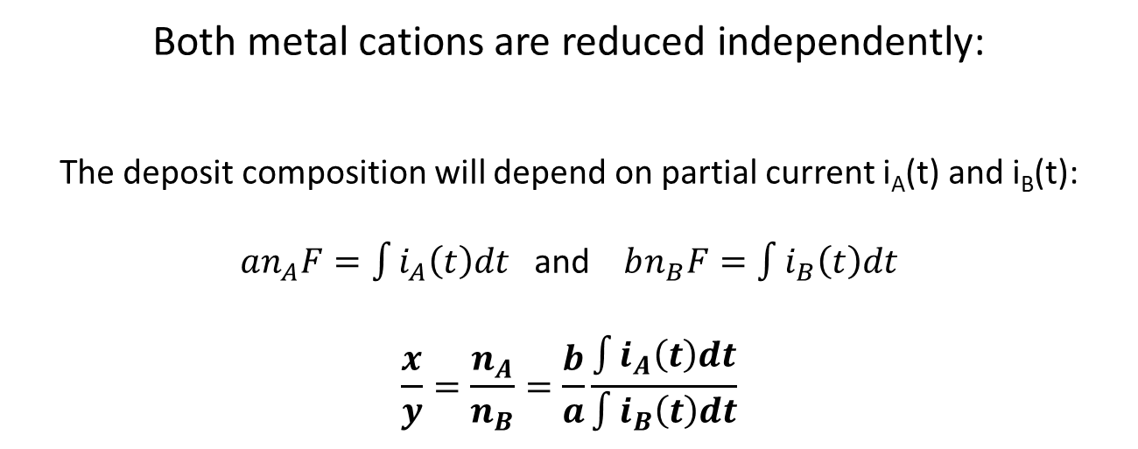

II) Electrodeposition of several elements
2) Co-deposition process
Both metal cations are reduced independently:
The deposit composition will depend on partial current i_{A}(t) and i_{B}(t):
$an_{A}F=\int{i_{A}\left(t\right)dt}$ and $bn_{B}F=\int{i_{B}\left(t\right)dt}$
$$\frac{x}{y}=\frac{n_{A}}{n_{B}}=\frac{b}{a}\frac{\int{i_{A}\left(t\right)dt}}{\int{i_{B}\left(t\right)dt}}$$
Case 3: $η_{A}≫η_{B}$ $j_{A}=aFC_{A}^{0}\sqrt{\frac{D_{A}}{πt}}$and $j_{B}≈j_{0}^{B}∙\frac{bFη_{B}}{RT}$
$$\frac{n_{A}}{n_{B}}=\frac{2}{π}\frac{C_{A}D_{A}}{j_{0}^{B}η_{B}}RTt^{−0.5}$$
Depends on concentrations, η_{B}, and time $⇒$ composition gradient

Slide 16
II) Electrodeposition of several elements
2) Co-deposition process
Both metal cations are reduced independently:
What morphology may you expect?
How could you correct it?
i
$$B^{0}→B^{b+}+be^{−}$$
E_{ECD}
$$A^{0}→A^{a+}+ae^{−}$$
E
$$i_{lim}^{B}$$
$$i_{lim}^{A}$$
$$i_{lim}^{A}+i_{lim}^{B}$$
$$A^{0}←A^{a+}+ae^{−}$$
$$B^{0}←B^{b+}+be^{−}$$

Slide 17
II) Electrodeposition of several elements
3) The use of ligands
Let us consider cations A^{a+} and B^{b+}, both complexed by Ligands L^{α-}.
Starting from the Nernst equation for each cation, can you find what parameter will affect the difference between their equilibrium potentials?

Slide 18

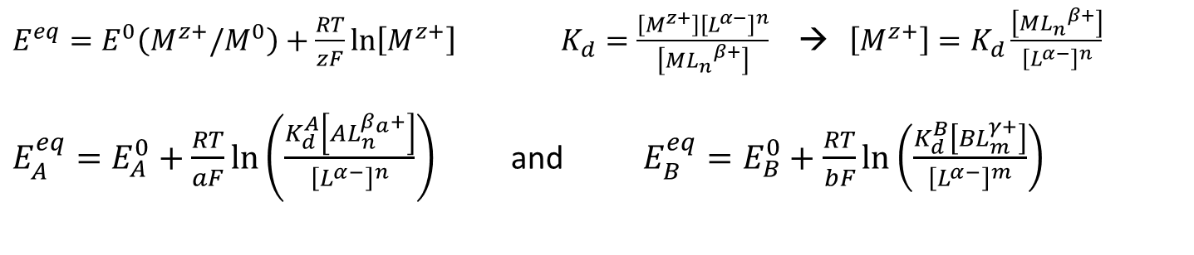









II) Electrodeposition of several elements
3) The use of ligands
$E^{eq}=E^{0}\left(M^{z+}/M^{0}\right)+\frac{RT}{zF}\ln\left[M^{z+}\right]$ $K_{d}=\frac{\left[M^{z+}\right]{\left[L^{α−}\right]}^{n}}{\left[{{ML}_{n}}^{β+}\right]}$ → $\left[M^{z+}\right]=K_{d}\frac{\left[{{ML}_{n}}^{β+}\right]}{{\left[L^{α−}\right]}^{n}}$
$E_{A}^{eq}=E_{A}^{0}+\frac{RT}{aF}\ln\left(\frac{K_{d}^{A}\left[AL_{n}^{β_{a}+}\right]}{{\left[L^{α−}\right]}^{n}}\right)$ and $E_{B}^{eq}=E_{B}^{0}+\frac{RT}{bF}\ln\left(\frac{K_{d}^{B}\left[BL_{m}^{γ+}\right]}{{\left[L^{α−}\right]}^{m}}\right)$
$$B^{0}→B^{b+}+be^{−}$$
i
$$B^{0}+mL^{α−}→{BL}_{m}^{γ+}+be^{−}$$
$$A^{0}+nL^{α−}→{AL}_{n}^{β+}+ae^{−}$$
$$A^{0}→A^{a+}+ae^{−}$$
$$b∆E∝$$
$${pK}_{d}^{B}−m{pL}^{α−}$$
$$a∆E∝$$
$${pK}_{d}^{A}−n{pL}^{α−}$$
E
$$i_{lim}^{B}$$
$$i_{lim}^{A}$$
$$A^{0}←A^{a+}+ae^{−}$$
$$B^{0}+mL^{α−}←{BL}_{m}^{γ+}+be^{−}$$
$$A^{0}+nL^{α−}←{AL}_{n}^{β+}+ae^{−}$$
$$B^{0}←B^{b+}+be^{−}$$

Slide 19
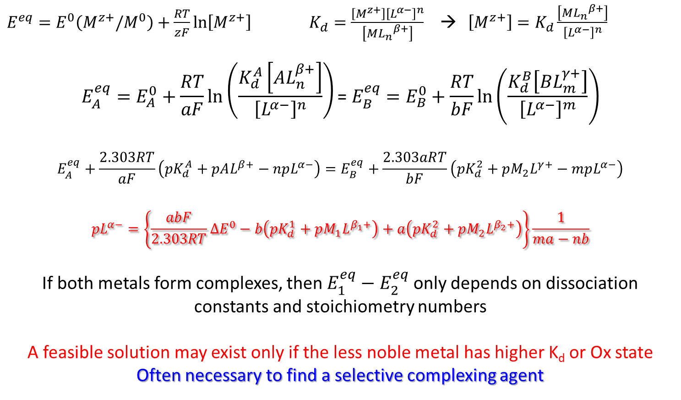
II) Electrodeposition of several elements
3) The use of ligands
$E^{eq}=E^{0}\left(M^{z+}/M^{0}\right)+\frac{RT}{zF}\ln\left[M^{z+}\right]$ $K_{d}=\frac{\left[M^{z+}\right]{\left[L^{α−}\right]}^{n}}{\left[{{ML}_{n}}^{β+}\right]}$ → $\left[M^{z+}\right]=K_{d}\frac{\left[{{ML}_{n}}^{β+}\right]}{{\left[L^{α−}\right]}^{n}}$
$$E_{A}^{eq}=E_{A}^{0}+\frac{RT}{aF}\ln\left(\frac{K_{d}^{A}\left[AL_{n}^{β+}\right]}{{\left[L^{α−}\right]}^{n}}\right) \text{=} E_{B}^{eq}=E_{B}^{0}+\frac{RT}{bF}\ln\left(\frac{K_{d}^{B}\left[BL_{m}^{γ+}\right]}{{\left[L^{α−}\right]}^{m}}\right)$$
$$E_{A}^{eq}+\frac{2.303RT}{aF}\left({pK}_{d}^{A}+pAL^{β+}−npL^{α−}\right)=E_{B}^{eq}+\frac{2.303aRT}{bF}\left({pK}_{d}^{2}+pM_{2}L^{γ+}−mpL^{α−}\right)$$
$$pL^{α−}=\left\{\frac{abF}{2.303RT}∆E^{0}−b\left({pK}_{d}^{1}+pM_{1}L^{β_{1}+}\right)+a\left({pK}_{d}^{2}+pM_{2}L^{β_{2}+}\right)\right\}\frac{1}{ma−nb}$$
If both metals form complexes, then $E_{1}^{eq}−E_{2}^{eq}$only depends on dissociation constants and stoichiometry numbers
A feasible solution may exist only if the less noble metal has higher K_{d} or Ox state
Often necessary to find a selective complexing agent

Slide 20
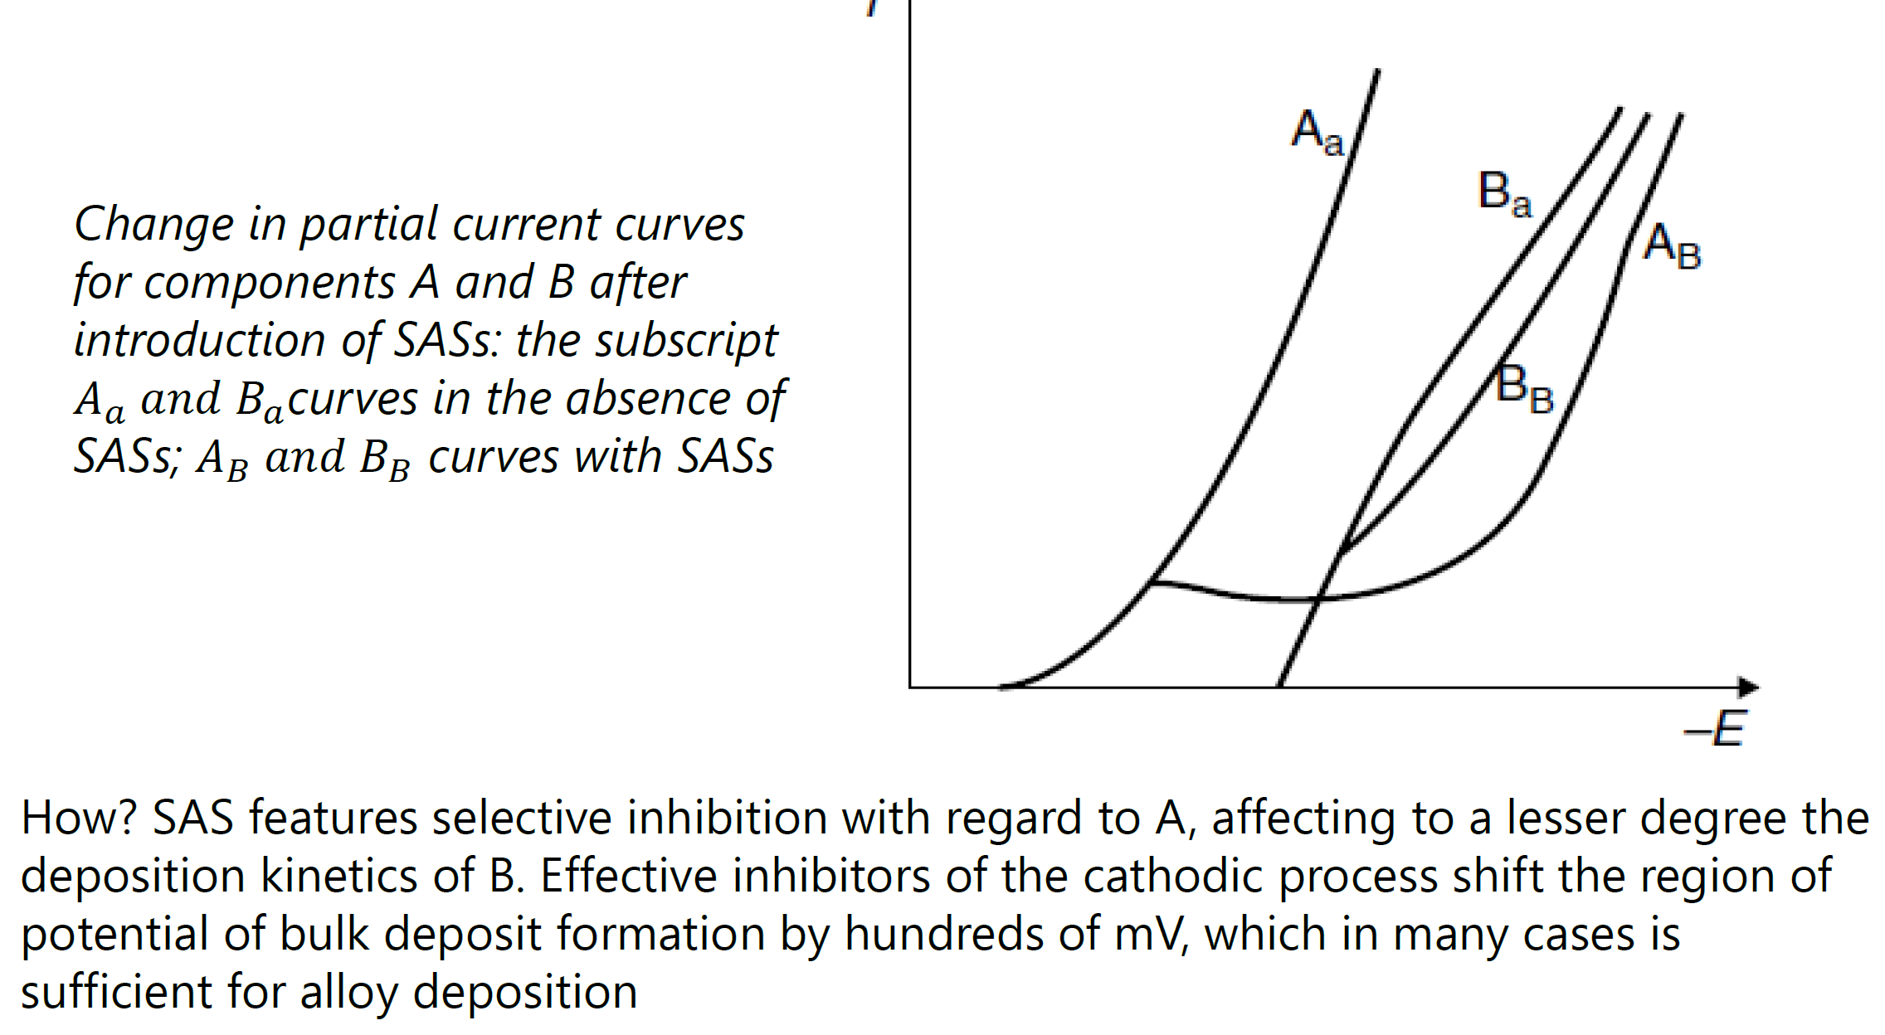
II) Electrodeposition of several elements
3) The use of surface active substances

Slide 21
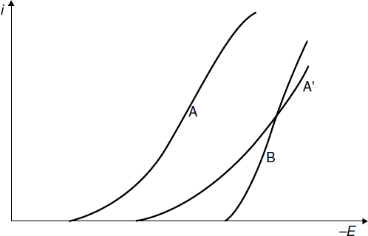
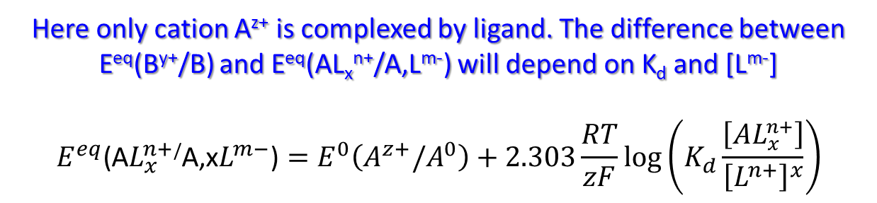
II) Electrodeposition of several elements
4) The use of ligands
Variation of the partial current curve of component A upon complex formation
Here only cation A^{z+} is complexed by ligand. The difference between E^{eq}(B^{y+}/B) and E^{eq}(AL_{x}^{n+}/A,L^{m-}) will depend on K_{d} and [L^{m-}]
$$E^{eq}\text{(}\text{A}L_{x}^{n+}\text{/}\text{A}\text{,}\text{x}L^{m−}\text{)}=E^{0}\left(A^{z+}/A^{0}\right)+2.303\frac{RT}{zF}\log\left(K_{d}\frac{\left[AL_{x}^{n+}\right]}{{\left[L^{n+}\right]}^{x}}\right)$$

Slide 22




II) Electrodeposition of several elements
2) Co-deposition process
Both metal cations are reduced independently:
Co-deposition of A and B is carried out at:
- low overpotentials for both cations: linearized Butler-Volmer
- No mass limitation: C_{el} = C⁰.
Express the ratio $\frac{n_{a}}{n_{b}}$ !
i
$$B^{0}→B^{b+}+be^{−}$$
E_{ECD}
$$A^{0}+nL^{α−}→{ALn}^{β+}+ae^{−}$$
E
$$i_{lim}^{B}$$
$$i_{lim}^{A}$$
$$A^{0}+nL^{α−}←{ALn}^{β+}+ae^{−}$$
$$B^{0}←B^{b+}+be^{−}$$

Slide 23

II) Electrodeposition of several elements
2) Co-deposition process
Both metal cations are reduced independently:
The deposit composition will depend on partial current i_{A}(t) and i_{B}(t):
$an_{A}F=\int{i_{A}\left(t\right)dt}$ and $bn_{B}F=\int{i_{B}\left(t\right)dt}$
$$\frac{x}{y}=\frac{n_{A}}{n_{B}}=\frac{b}{a}\frac{\int{i_{A}\left(t\right)dt}}{\int{i_{B}\left(t\right)dt}}$$
Case 2: low overpotentials $j≈j_{0}∙\frac{zFη}{RT}$ (Butler-Volmer linear approx.)
$$\frac{n_{A}}{n_{B}}=\frac{ j_{0}^{A}}{j_{0}^{B}}\frac{η_{A}}{η_{B}}$$
Composition depends on exchange currents and overpotentials

Slide 24
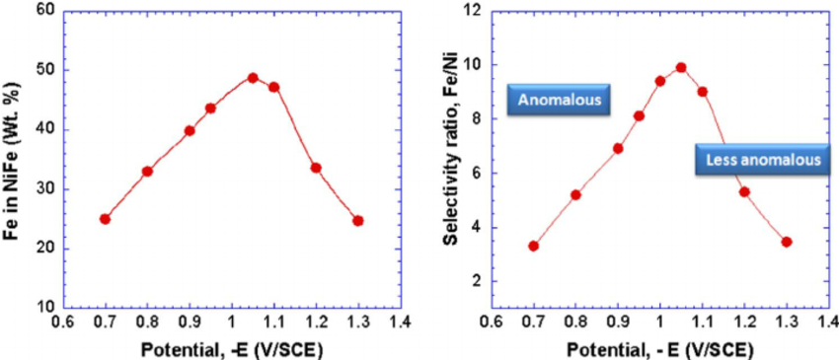
II) Electrodeposition of several elements
5) Anomalous co-deposition
The less noble metal becomes the more noble metal
The electrodeposit composition tendency towards overpotential reverts
Observed for numerous Ni intermetallic alloys (NiFe, NiCo…)

Slide 25
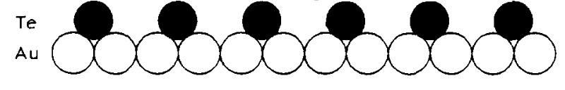
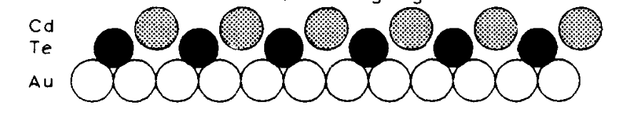
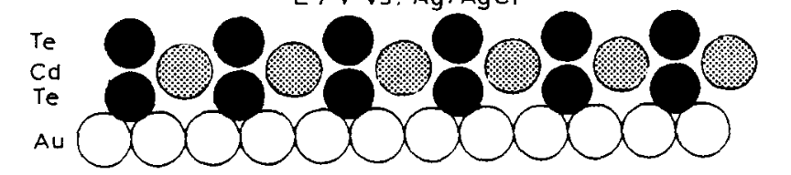
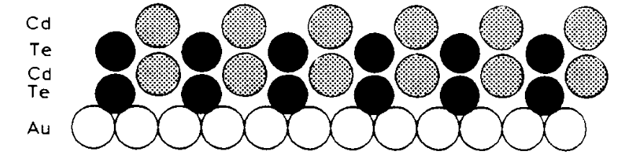
II) Electrodeposition of several elements
6) Consecutive UPD layers
The nucleation of A on substrate S performs with Δσ < 0
Then a monoatomic layer of A on S can be deposited at E > E_{eq}
The nucleation of B on monolayer A occurs with Δσ < 0
Then a monoatomic layer of A on B can be deposited at E > E_{eq}
The nucleation of B on monolayer A performs with Δσ < 0
Then a monoatomic layer of B on A can be deposited at E > E_{eq}
.
.
.
.
Repeat as many time as necessary to reach the desired thickness

Slide 26
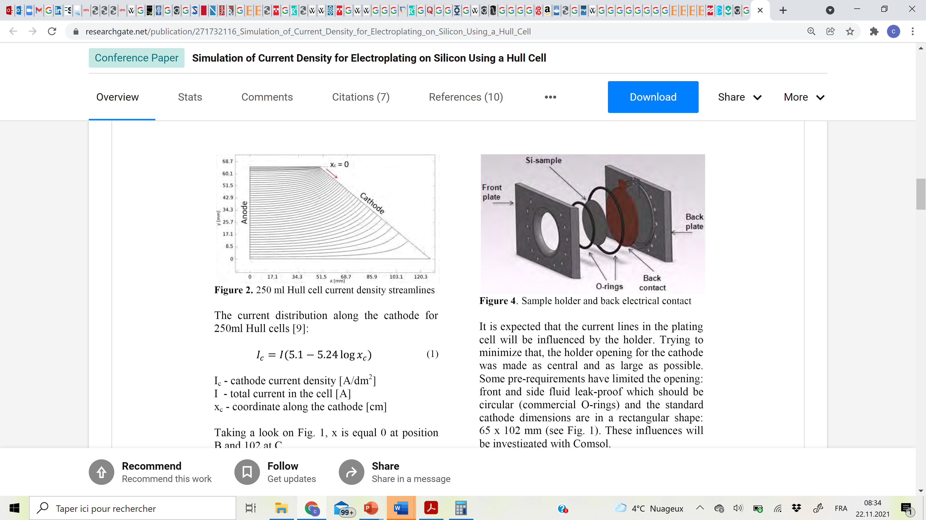
III) Quick ECD optimizations
1) The Hull cell
Cathode surface area = 66.3 cm²
The composition and growth rate of the electrodeposit may vary with the position x_{c}
The deposit morphology and microstrucure may vary with the position x_{c}
Quick optimization of the current density
Assessment of the macrothrowing power
Difficult to apply ideal agitation: studies normally performed under natural diffusion

Slide 27
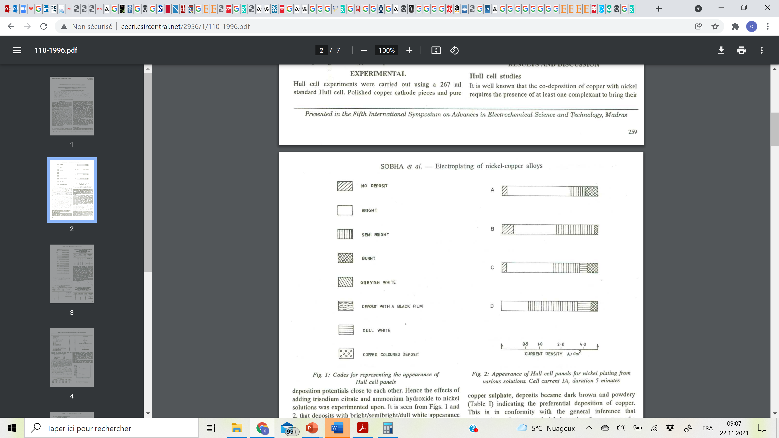
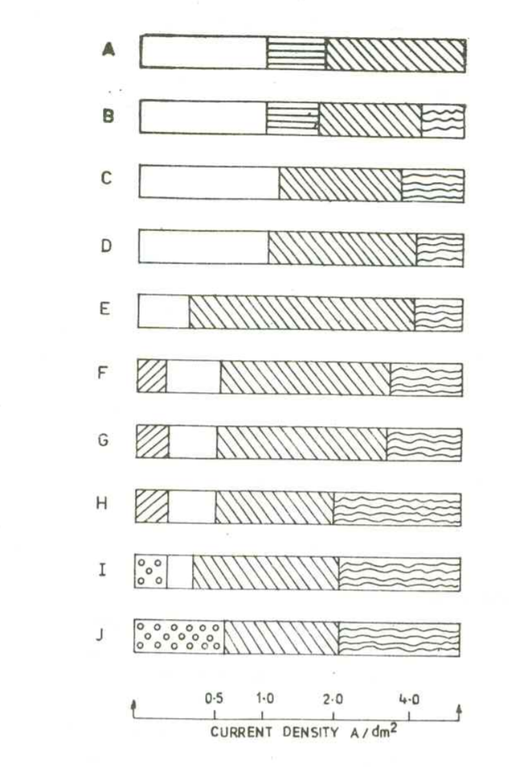
III) Quick ECD optimizations
1) The Hull cell
[Ni²⁺] in different electrolytes
Increasing [Cu²⁺]

Slide 28
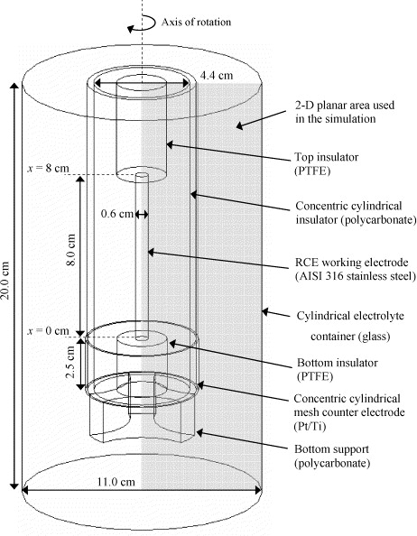
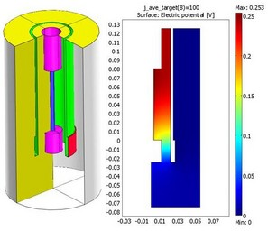
III) Quick ECD optimizations
2) The rotating cylinder Hull cell

Slide 29
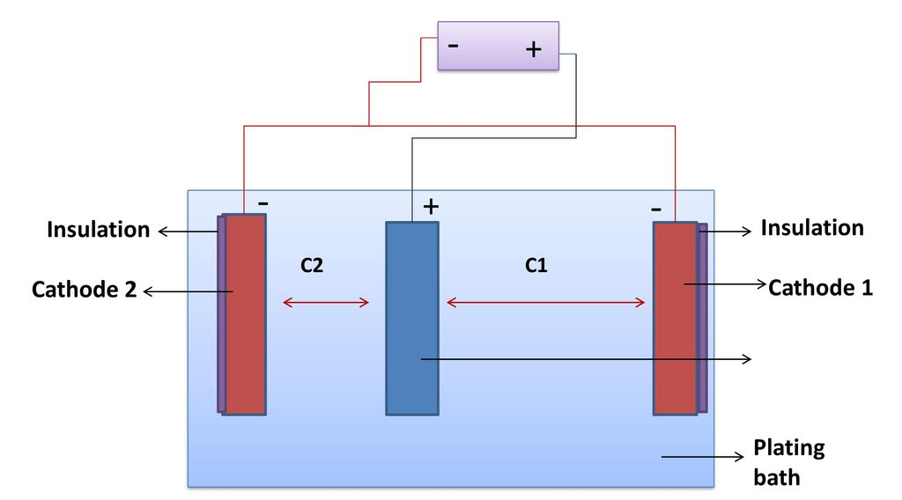
III) Quick ECD optimizations
3) The Haring-Blum cell
Used to evaluate of the macrothrowing power:
Optimization of levellers!

Slide 30
II) Electrodeposition of several elements
7) The Hull cell
Cathode surface area = 66.3 cm²
Cu and Ni are codeposited at pH 9 in a Hull cell with a total current of 1 A
E⁰(Cu²⁺/Cu) = 0.16 V vs NHE, [Cu²⁺] = 0.05 M, j_{lim} = 275 mA.dm⁻²
E⁰(Ni²⁺/Ni) = -0.23 V vs NHE, [Ni²⁺] = 0.2 M, j_{lim} = 555 mA.dm⁻²
Can you estimate the composition profile along x_{c}?
Can you predict the current efficiency?
We consider that only HER occurs as a side reaction and that j_{HER} = j_{tot} - j_{lim,Cu} - j_{lim,Ni}

Slide 31
II) Electrodeposition of several elements
7) The Hull cell
Let us define limit conditions:
1) There exist a value x_{c} above which 5.1 – 5.24 log x_{c} ≤ 0
x_{c}⁽¹⁾ = 10^{(5.1/5.24)} = 9.403 cm
2) E⁰(Cu²⁺/Cu) >> E⁰(Ni²⁺/Ni): if I_{C} ≤ j_{lim}(Cu) then only copper is deposited
x_{c}⁽²⁾ = 10^{((5.1-0.275)/5.24)} = 8.333 cm
3) E^{eq}(H⁺/H₂) = E⁰(H⁺/H₂) – 0.059 pH = 0.531 V vs NHE << E⁰(Ni²⁺/Ni)
HER only occurs when I_{C} > j_{lim}^{(Cu)} + j_{lim}^{(Ni)}
x_{c}⁽³⁾ = 10^{((5.1-0.275-0.555)/5.24)} = 6.530 cm
x_{c}
^{10.2 cm}
x_{c}⁽¹⁾
x_{c}⁽²⁾
x_{c}⁽³⁾
x_{c}
^{0 cm}

Slide 32
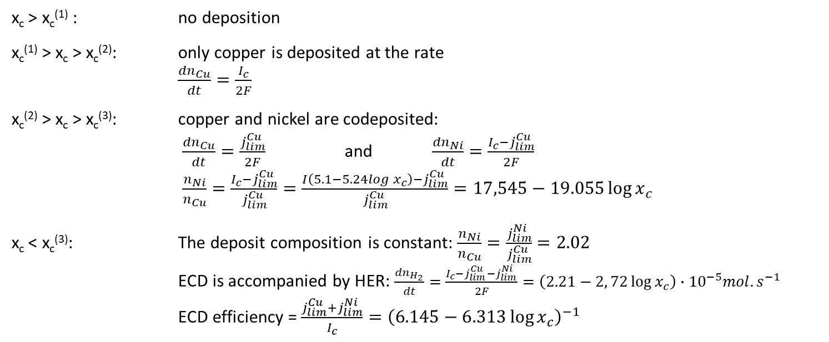
II) Electrodeposition of several elements
7) The Hull cell
x_{c} > x_{c}⁽¹⁾ : no deposition
x_{c}⁽¹⁾ > x_{c} > x_{c}⁽²⁾: only copper is deposited at the rate
$\frac{{dn}_{Cu}}{dt}=\frac{I_{c}}{2F}$
x_{c}⁽²⁾ > x_{c} > x_{c}⁽³⁾: copper and nickel are codeposited:
$\frac{{dn}_{Cu}}{dt}=\frac{j_{lim}^{Cu}}{2F}$ and $\frac{{dn}_{Ni}}{dt}=\frac{I_{c}−j_{lim}^{Cu}}{2F}$
$\frac{n_{Ni}}{n_{Cu}}=\frac{I_{c}−j_{lim}^{Cu}}{j_{lim}^{Cu}}=\frac{I\left(5.1−5.24log{ x}_{c}\right)−j_{lim}^{Cu}}{j_{lim}^{Cu}}=17,545−19.055\log{x_{c}}$
x_{c} < x_{c}⁽³⁾: The deposit composition is constant: $\frac{n_{Ni}}{n_{Cu}}=\frac{j_{lim}^{Ni}}{j_{lim}^{Cu}}=2.02$
ECD is accompanied by HER: $\frac{{dn}_{H_{2}}}{dt}=\frac{I_{c}−j_{lim}^{Cu}−j_{lim}^{Ni}}{2F}=\left(2.21−2, 72\log{x_{c}}\right)∙{10}^{−5}mol.s^{−1}$
ECD efficiency = $\frac{j_{lim}^{Cu}+j_{lim}^{Ni}}{I_{c}}={\left(6.145−6.313\log{x_{c}}\right)}^{−1}$
x_{c}
^{10.2 cm}
x_{c}⁽¹⁾
x_{c}⁽²⁾
x_{c}⁽³⁾
x_{c}
^{0 cm}

Slide 33
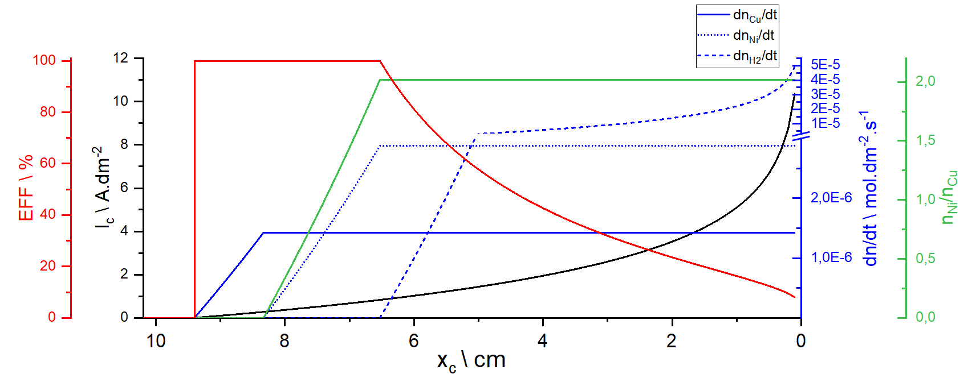
II) Electrodeposition of several elements
7) The Hull cell
x_{c}
^{10.2 cm}
x_{c}⁽¹⁾
x_{c}⁽²⁾
x_{c}⁽³⁾
x_{c}
^{0 cm}

Slide 34
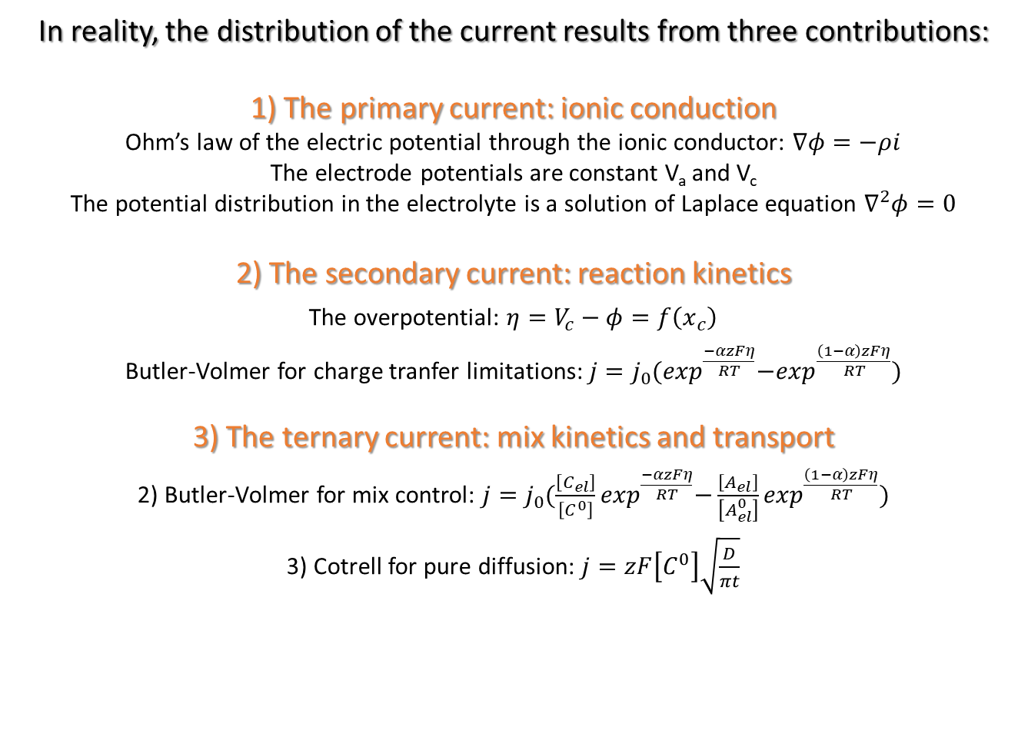
II) Electrodeposition of several elements
7) The Hull cell
In reality, the distribution of the current results from three contributions:
1) The primary current: ionic conduction
Ohm’s law of the electric potential through the ionic conductor: $∇φ=−ρi$
The electrode potentials are constant V_{a} and V_{c}
The potential distribution in the electrolyte is a solution of Laplace equation $∇^{2}φ=0$
2) The secondary current: reaction kinetics
The overpotential: $η=V_{c}−φ=f\left(x_{c}\right)$
Butler-Volmer for charge tranfer limitations: $j=j_{0}{(exp}^{\frac{−αzFη}{RT}}−\exp^{\frac{\left(1−α\right)zFη}{RT}})$
3) The ternary current: mix kinetics and transport
2) Butler-Volmer for mix control: $j=j_{0}{(\frac{\left[C_{el}\right]}{\left[C^{0}\right]}exp}^{\frac{−αzFη}{RT}}−\frac{\left[A_{el}\right]}{\left[A_{el}^{0}\right]}\exp^{\frac{\left(1−α\right)zFη}{RT}})$
3) Cotrell for pure diffusion: $j=zF\left[C^{0}\right]\sqrt{\frac{D}{πt}}$
Typically, simulations are performed to determine the exact current distribution

